Slide 1
End-to-end systems 1: CTC (Connectionist Temporal Classification)
Most slides come from http://www.inf.ed.ac.uk/teaching/courses/asr/2020-21/asr05-hmm-algorithms.pdf
Ying shen
School of software engineering
Tongji university

Slide 2
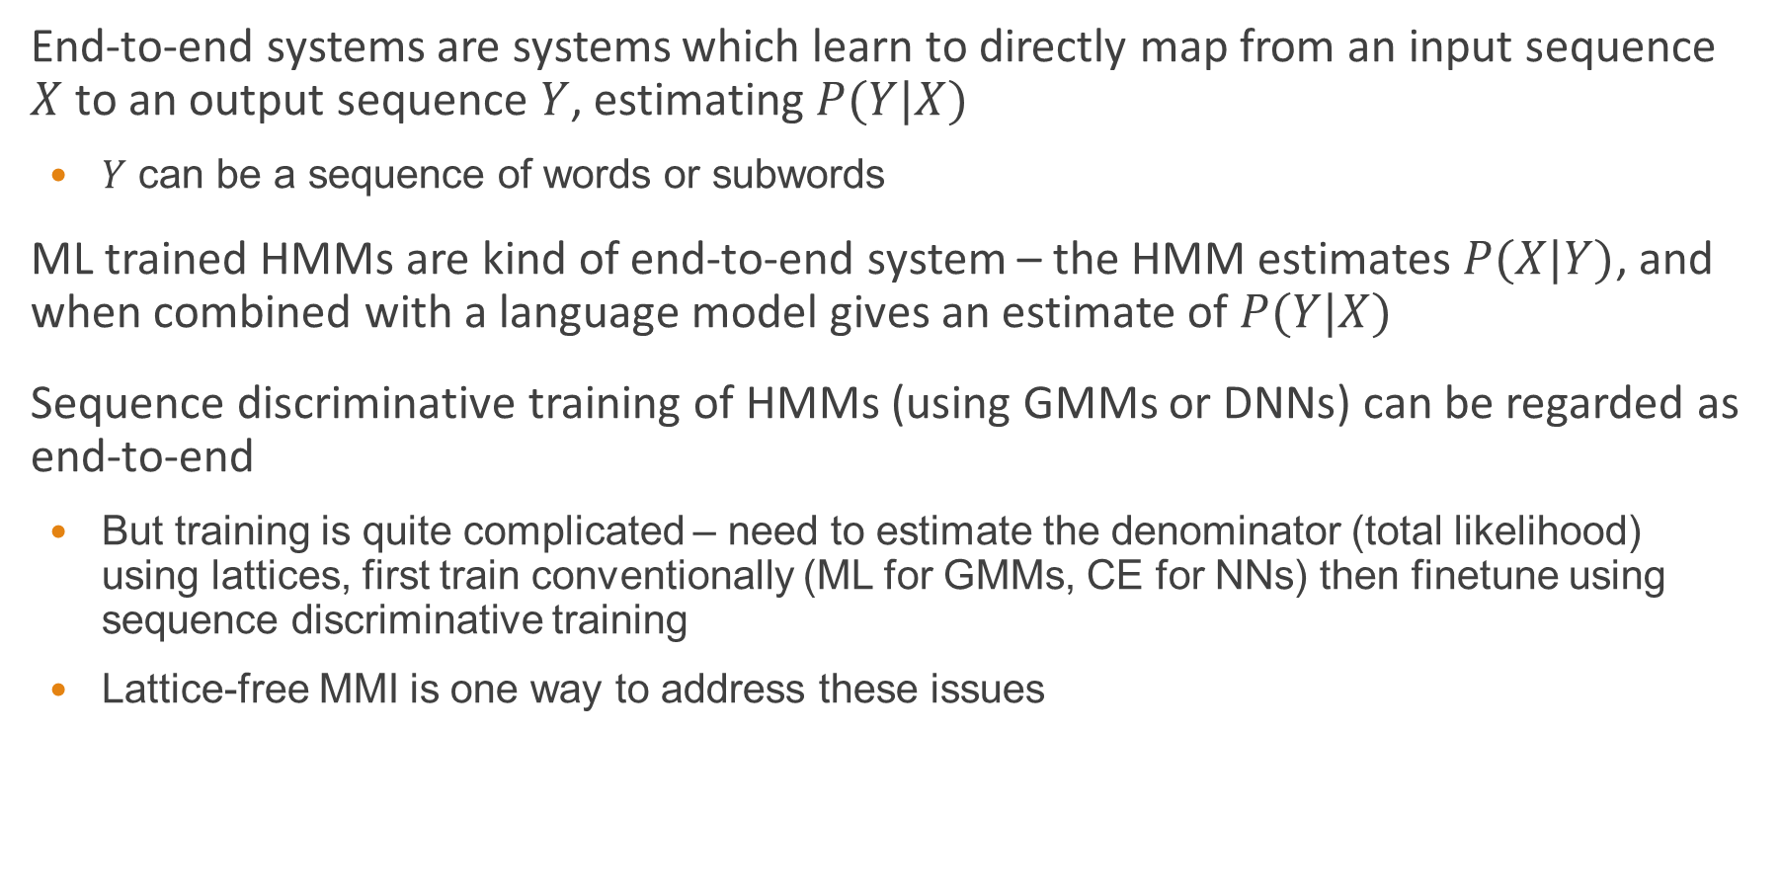
End-to-end systems
End-to-end systems are systems which learn to directly map from an input sequence $X$ to an output sequence $Y$, estimating $P(Y|X)$
$Y$ can be a sequence of words or subwords
ML trained HMMs are kind of end-to-end system – the HMM estimates $P(X|Y)$, and when combined with a language model gives an estimate of $P(Y|X)$
Sequence discriminative training of HMMs (using GMMs or DNNs) can be regarded as end-to-end
But training is quite complicated – need to estimate the denominator (total likelihood) using lattices, first train conventionally (ML for GMMs, CE for NNs) then finetune using sequence discriminative training
Lattice-free MMI is one way to address these issues

Slide 3
Fully differentiable end-to-end systems
Approaches based purely on recurrent networks which directly map input to output sequences
CTC – Connectionist Temporal Classification
Encoder-decoder approaches
No need for specialized HMM-style decoders (although they can still be used)

Slide 4
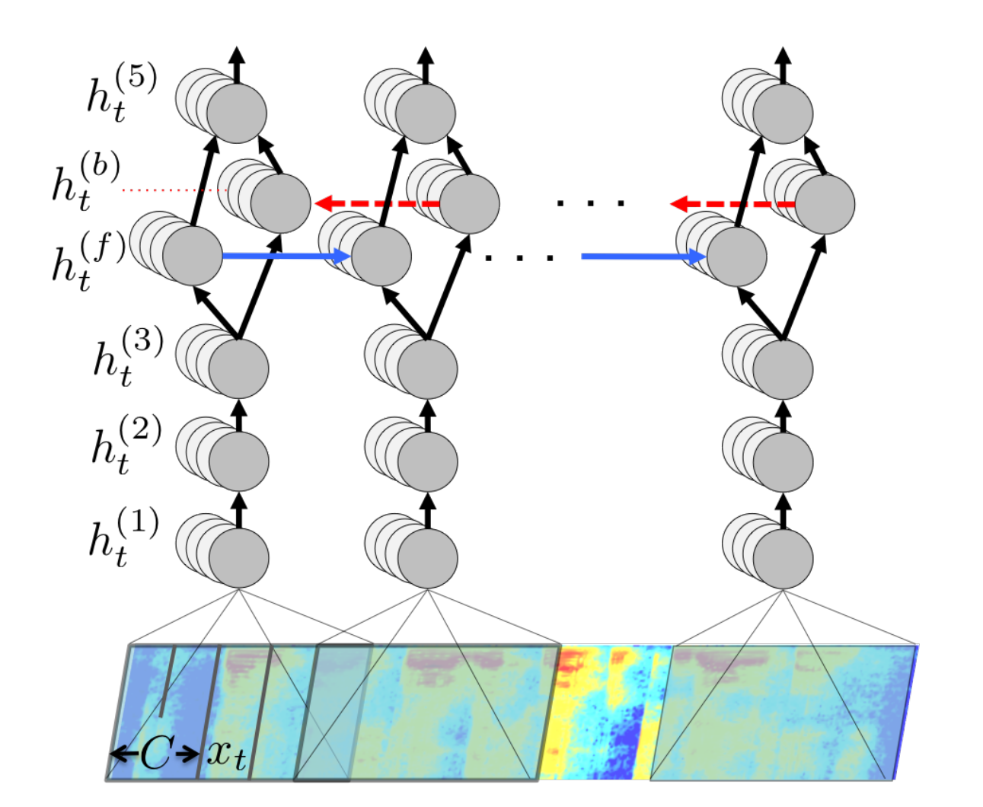
Example: Deep Speech
Hannun et al (2014), “Deep Speech: Scaling up end-to-end speech recognition”

Slide 5
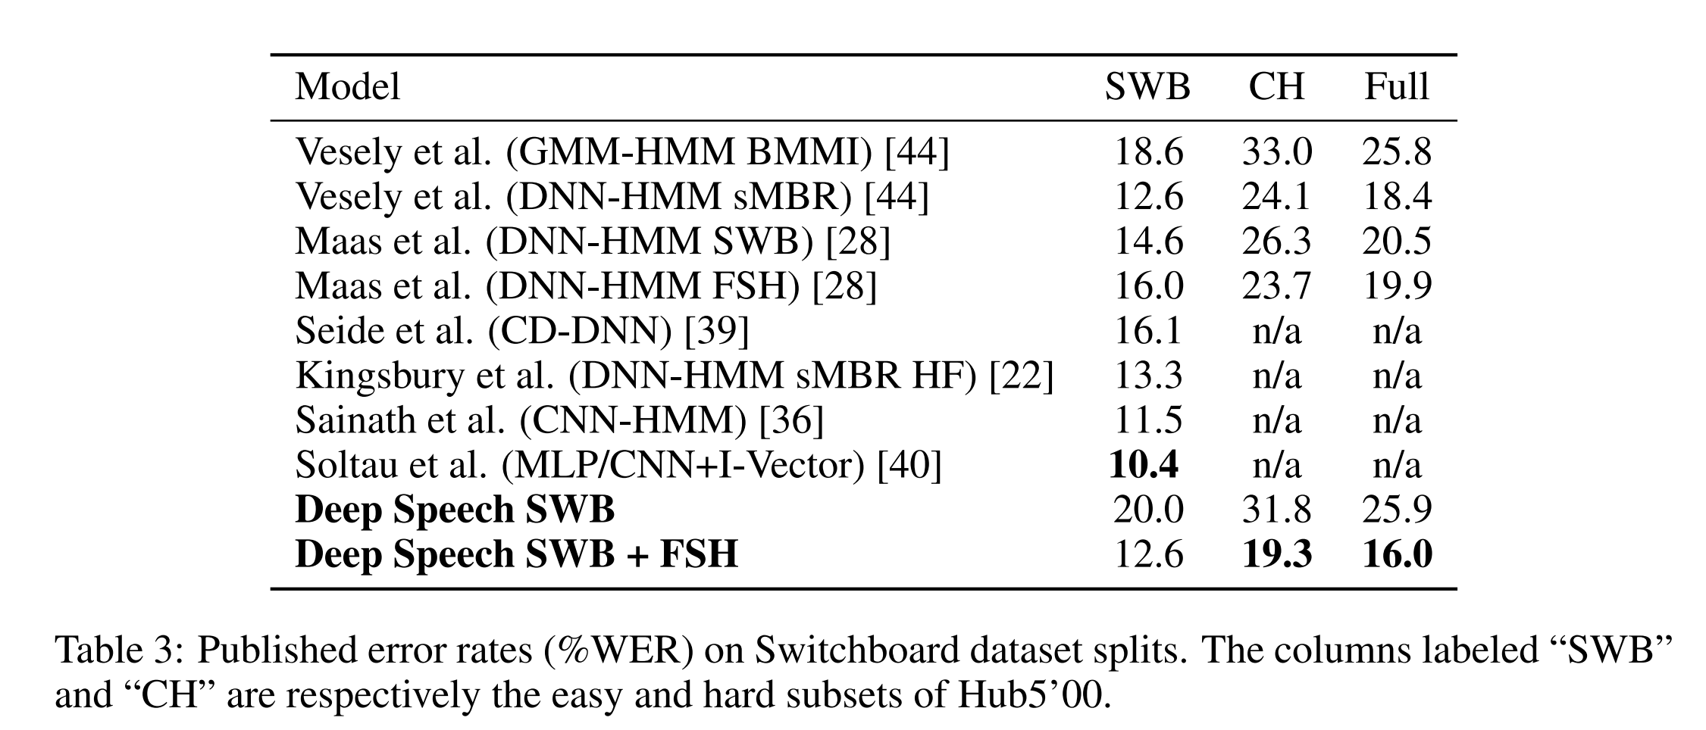
Deep Speech: Results

Slide 6
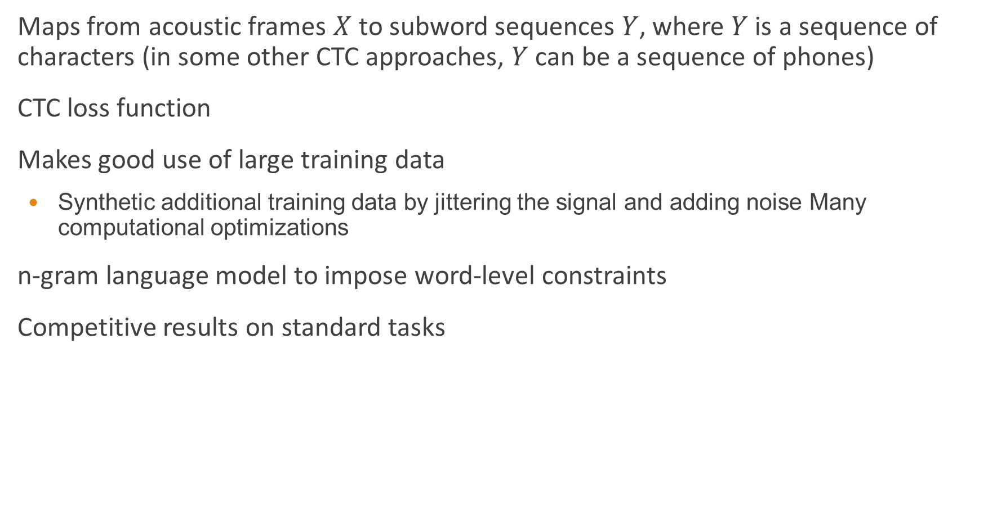
Deep Speech Training
Maps from acoustic frames $X$ to subword sequences $Y$, where $Y$ is a sequence of characters (in some other CTC approaches, $Y$ can be a sequence of phones)
CTC loss function
Makes good use of large training data
Synthetic additional training data by jittering the signal and adding noise Many computational optimizations
n-gram language model to impose word-level constraints
Competitive results on standard tasks

Slide 7
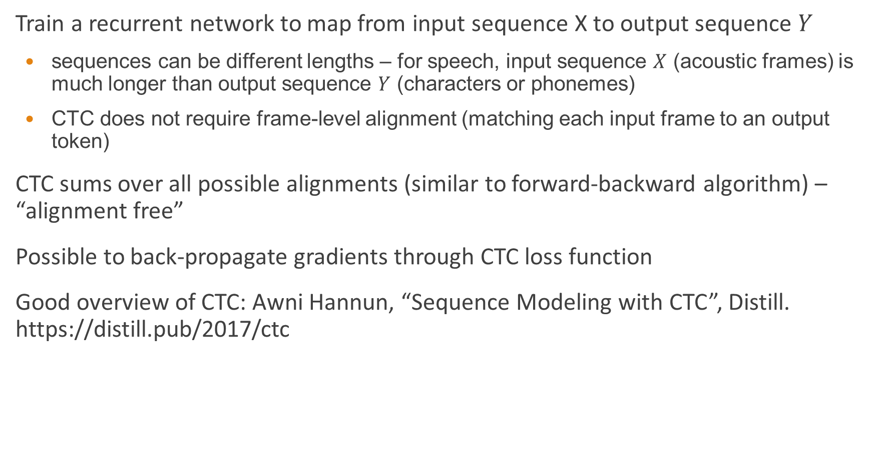
Connectionist Temporal Classification (CTC)
Train a recurrent network to map from input sequence X to output sequence $Y$
sequences can be different lengths – for speech, input sequence $X$ (acoustic frames) is much longer than output sequence $Y$ (characters or phonemes)
CTC does not require frame-level alignment (matching each input frame to an output token)
CTC sums over all possible alignments (similar to forward-backward algorithm) – “alignment free”
Possible to back-propagate gradients through CTC loss function
Good overview of CTC: Awni Hannun, “Sequence Modeling with CTC”, Distill. https://distill.pub/2017/ctc

Slide 8
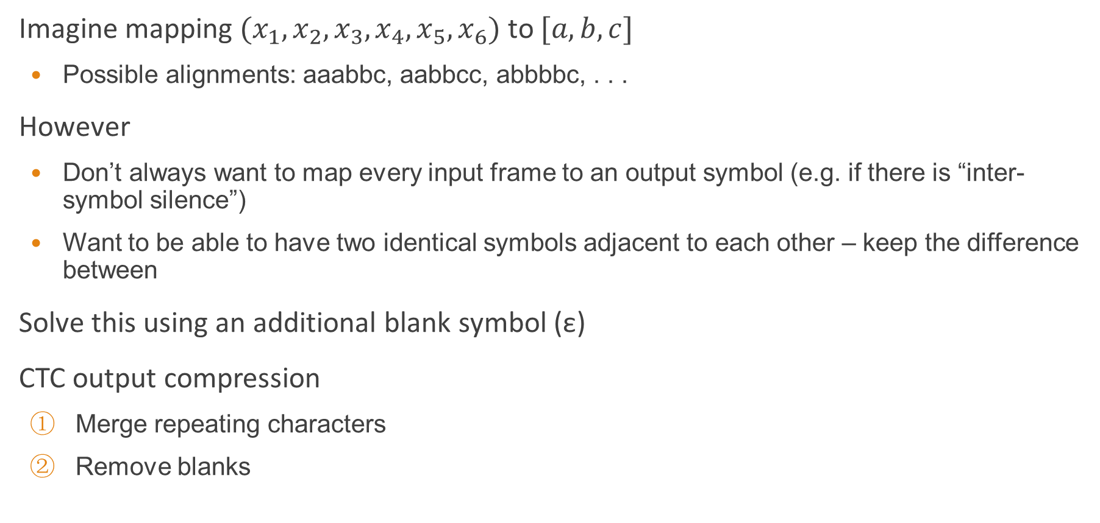
CTC: Alignment
Imagine mapping $(x_{1}, x_{2}, x_{3}, x_{4}, x_{5}, x_{6})$ to $[a, b, c]$
Possible alignments: aaabbc, aabbcc, abbbbc, . . .
However
Don’t always want to map every input frame to an output symbol (e.g. if there is “inter-symbol silence”)
Want to be able to have two identical symbols adjacent to each other – keep the difference between
Solve this using an additional blank symbol (ε)
CTC output compression
Merge repeating characters
Remove blanks

Slide 9
CTC: Alignment
CTC output compression
Merge repeating characters
Remove blanks
Thus to model the same character successively, separate with a blank
Some possible alignments for [h, e, l, l, o] and [h, e, l, o] given a 10-element input sequence
[h, e, l, l, o]: hεεeεllεlo; heεllεlεoo
[h, e, l, o]: hεεeεllllo; hhεeεlεεoε

Slide 10
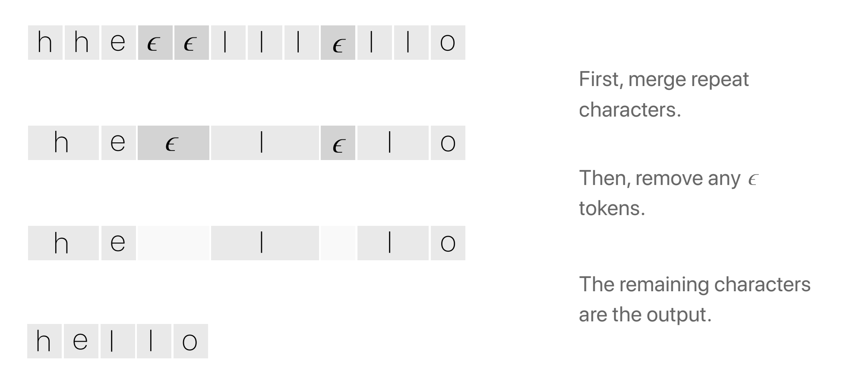
CTC: Alignment example

Slide 11
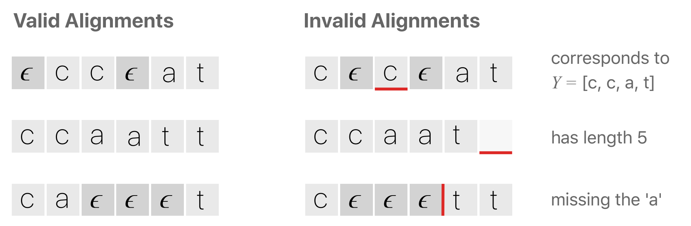
CTC: Valid and invalid alignments
Consider an output [c, a, t] with an input of length six

Slide 12
CTC: Alignment properties
Monotonic – Alignments are monotonic (left-to-right model); no re-ordering (unlike neural machine translation)
Many-to-one – Alignments are many-to-one; many inputs can map to the same output
But a single input cannot map to many outputs – could be a problem for sounds like “th”
CTC doesn’t find a single alignment: it sums over all possible alignments

Slide 13
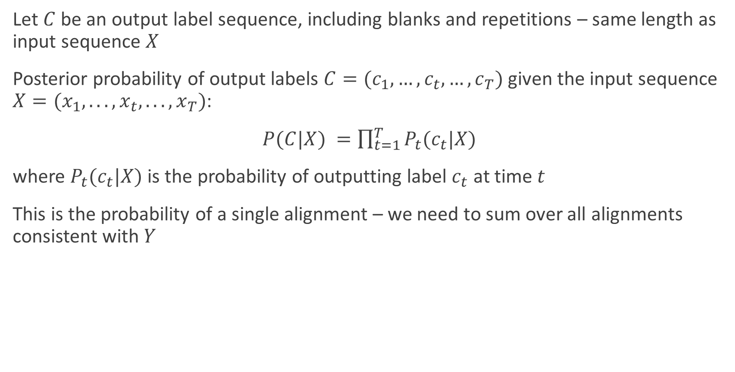
CTC: Loss function (1)
Let $C$ be an output label sequence, including blanks and repetitions – same length as input sequence $X$
Posterior probability of output labels $C=(c_{1},…,c_{t},…,c_{T})$ given the input sequence $X=(x_{1}, . . . , x_{t}, . . . ,x_{T})$:
$P(C|X) =\prod_{t=1}^{T}{P_{t}(c_{t}|X)}$
where $P_{t}(c_{t}|X)$ is the probability of outputting label $c_{t}$ at time $t$
This is the probability of a single alignment – we need to sum over all alignments consistent with $Y$

Slide 14
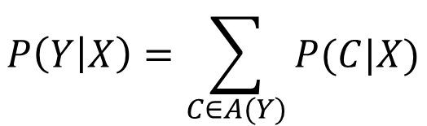
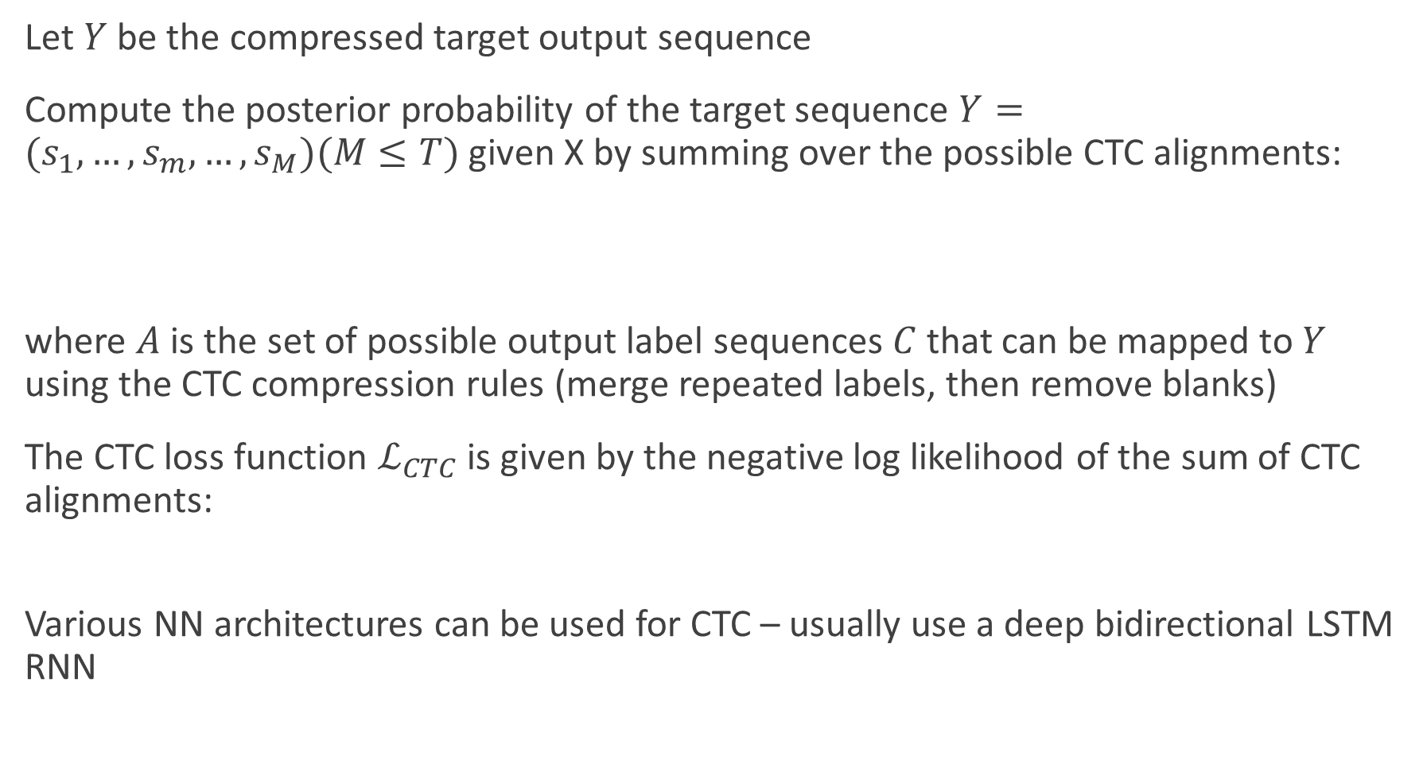

CTC: Loss function (2)
Let $Y$ be the compressed target output sequence
Compute the posterior probability of the target sequence $Y=(s_{1},…,s_{m},…,s_{M})(M≤T)$ given X by summing over the possible CTC alignments:
where $A$ is the set of possible output label sequences $C$ that can be mapped to $Y$ using the CTC compression rules (merge repeated labels, then remove blanks)
The CTC loss function $ℒ_{CTC}$ is given by the negative log likelihood of the sum of CTC alignments:
Various NN architectures can be used for CTC – usually use a deep bidirectional LSTM RNN
$$P\left(Y | X\right)=\sum_{C∈A(Y)}{P(C|X)}$$
$$ℒ_{CTC}=−\log{P(Y|X)}$$

